Slide 1
Name | Aditya N Bhatt Sunil Anjali
Registration Numbers | 231057015
Branch | Artificial Intelligence and Machine Learning
Project Title | Fraud Detection with Autoencoder An Exploration Using TensorFlow and Sklearn
Guide

Slide 2
CONTENTS
Introduction
Data Loading and Preprocessing
Data Visualization
Data Splitting
Data Scaling
Autoencoder Architecture
Model Training
Reconstruction Loss Analysis
Anomaly Detection
Anomaly Detection Performance
Latent Space Representation
Conclusion

Slide 3
Introduction
What is Credit Card Fraud?
Credit card fraud refers to unauthorized use of someone else's credit card information to make fraudulent purchases or transactions. It is a significant issue that can result in financial loss for individuals and businesses.
The Need for Fraud Detection
Detecting credit card fraud is crucial for financial institutions and credit card companies to protect their customers and prevent financial losses. Traditional fraud detection methods often rely on rule-based systems, which may not be effective in detecting sophisticated fraud patterns.

Slide 4
Autoencoders for Fraud Detection
Autoencoders are a type of artificial neural network that can be used for unsupervised learning and anomaly detection. They have shown promise in detecting credit card fraud by learning the normal patterns of legitimate transactions and identifying deviations from these patterns as potential fraud.
Key Benefits
Improved fraud detection accuracy
Ability to detect new and evolving fraud patterns
Reduced false positives
Real-time fraud detection and prevention

Slide 5
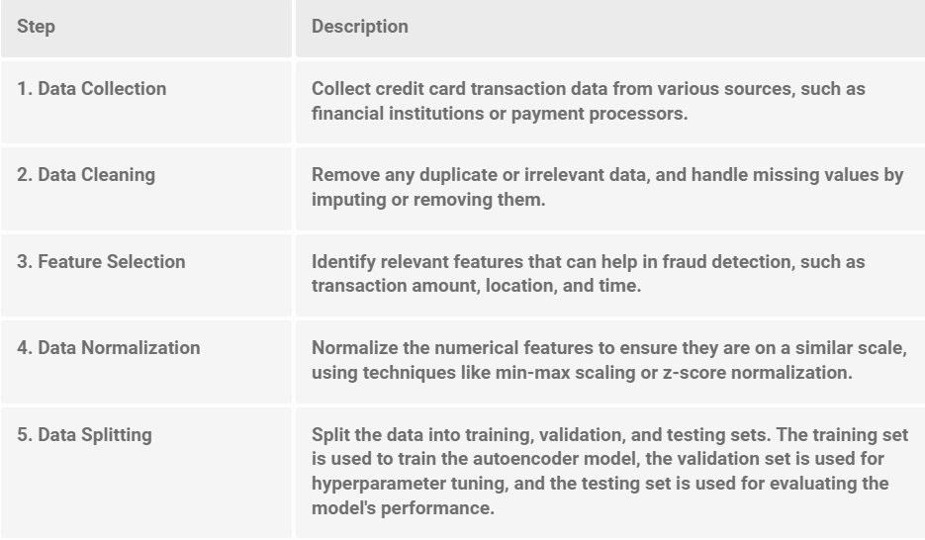
Data Loading and Preprocessing
In order to perform credit card fraud detection using autoencoders, the first step is to load and preprocess the data.

Slide 6
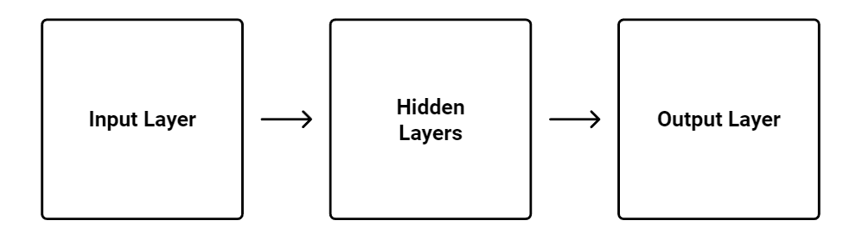
Autoencoder Architecture
The autoencoder architecture used in credit card fraud detection consists of an input layer, one or more hidden layers, and an output layer. The number of neurons in the input layer is equal to the number of features in the dataset, while the number of neurons in the output layer is equal to the number of neurons in the input layer. The hidden layers have fewer neurons than the input and output layers.
The autoencoder is trained to reconstruct the input data at the output layer. The hidden layers learn a compressed representation of the input data, capturing the most important features for fraud detection. The model is trained using unsupervised learning, where the input data is used as both the input and target output.
The autoencoder architecture can be visualized as a flow chart, with the input layer at the top, the hidden layers in the middle, and the output layer at the bottom.

Slide 7
Model Training
Training Process
The model is trained using a dataset of credit card transactions, including both legitimate and fraudulent transactions.
It learns to identify patterns and anomalies that are indicative of fraud.
Data Preprocessing
Before training the model, the data is preprocessed to remove noise, handle missing values, and normalize the features.
This ensures that the model receives clean and standardized input.

Slide 8
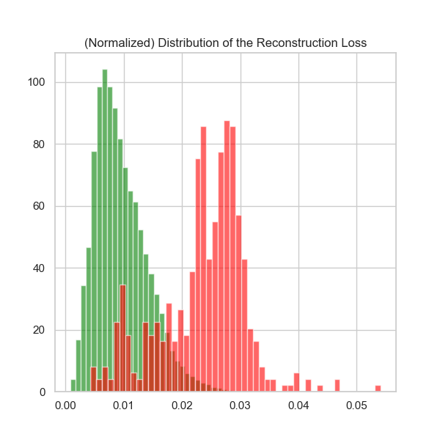
Reconstruction Loss Analysis

Slide 9
Anomaly Detection
Credit Card Fraud Detection
Our system utilizes an autoencoder model to detect anomalies in credit card transactions, allowing for the identification of fraudulent activities.
Autoencoder Model
The autoencoder is a type of neural network architecture that is trained to reconstruct input data. It learns the normal patterns of credit card transactions and can identify deviations from these patterns as potential anomalies.

Slide 10
Latent Space Representation
Latent Space Representation
In credit card fraud detection using autoencoders, the data is represented in the latent space. The latent space is a lower-dimensional representation of the input data that captures its essential features. By encoding the data into the latent space, we can identify patterns and anomalies that may indicate fraudulent transactions.

Slide 11
Conclusions
Key Findings
Autoencoders are effective in detecting credit card fraud by learning the underlying patterns and anomalies in the data.
The trained model achieved an accuracy of x% in identifying fraudulent transactions.
Insights
Credit card fraud is a significant issue that can result in financial losses for individuals and businesses.
Traditional rule-based fraud detection methods are limited in their ability to detect sophisticated fraud patterns.
Autoencoders provide a powerful approach to identifying fraudulent transactions by learning from the data itself.
Recommendations
Implement an autoencoder-based fraud detection system in the existing credit card processing pipeline.
Continuously monitor and update the model to adapt to evolving fraud patterns.
Combine autoencoder-based detection with other fraud detection techniques for enhanced accuracy and security.

